Slide 1
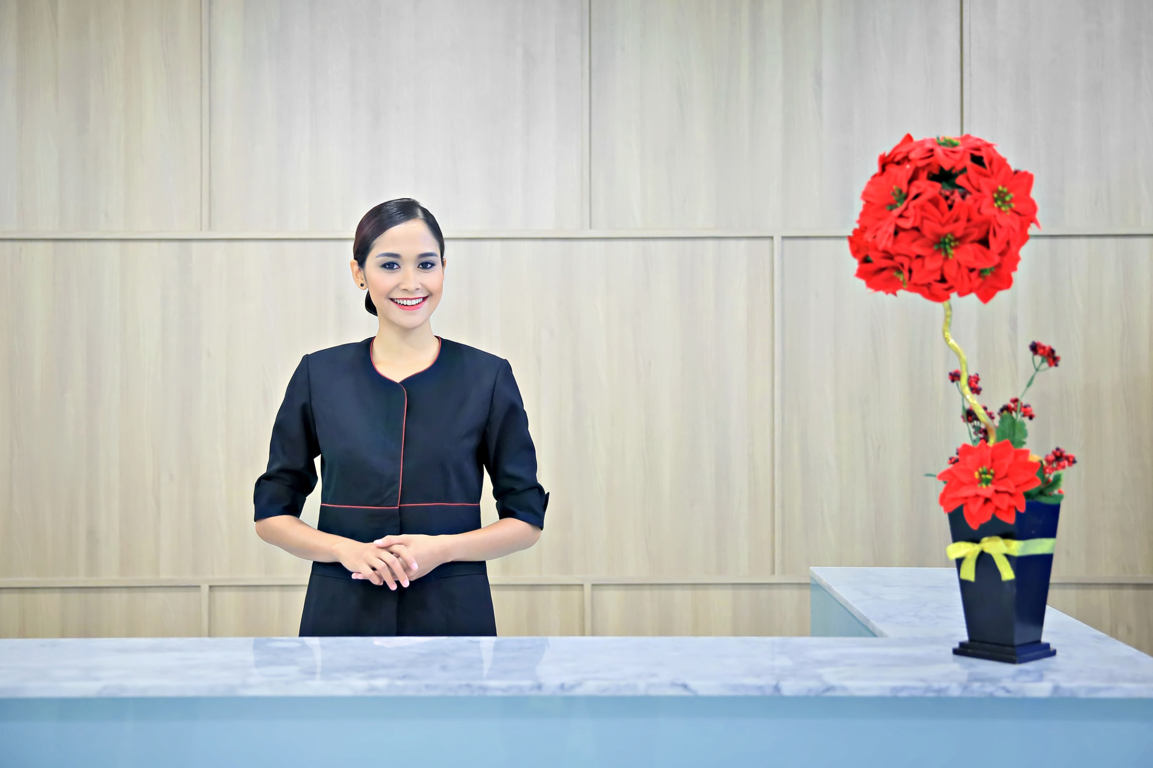
Welcome to

Slide 2
We provide one stop total solutions for new businesses, starting from virtual/in-house serviced offices, meetings & video conferencing facilities, and company set-up.
Established in 2010
Over 150 modernly designed office rooms
Over 500 virtual office clients
Additional 200 office rooms this year

Slide 3
INHOUSE SERVICED AND VIRTUAL OFFICE
Small office for 1 – 9 persons
Fully furnished and equipped
Flexible payment terms
Prestigious business addresses
Highly trained front-desk staffs
Professional secretarial service
On-site support team
Risk-free investment to start your business

Slide 4
MEETINGS & VIDEO CONFRENCING FACILITIES
Rooms capacity for up to 70 attendees with theatre style setting
Video conferencing facilities
LCD Projector
Whiteboard and/or flip chart
Secretarial service
Half-day/Full-day Meeting Packages with lunch and coffee-breaks

Slide 5
OUR LOCATIONS
Sentral Senayan 2, 16th Fl.
Jl. Asia Afrika No. 8,
Gelora Bung Karno, Jakarta
Allianz Tower, 29th Fl.
Jl. HR Rasuna Said, Superblok 2
Kawasan Kuningan Persada, Jakarta
Summitmas II, Ground Fl.
Jl. Jend. Sudirman Kav. 61-62, Jakarta
World Trade Center II, 18th Fl.
Jl. Jend. Sudirman Kav. 29-31, Jakarta
Graha Bukopin Building, 12th Fl.
Jl. Panglima Sudirman 10 – 18, Surabaya
MidPlaza 1, 17th Fl.
Jl. Jend. Sudirman Kav. 10-11, Jakarta

Slide 6
For more information and inquiries
Ph: +62 (21) 2929 5000 Jakarta
Ph: +62 (31) 2899 7989 Surabaya
Email: info@forticeoffice.com
Website: www.forticeoffice.com

